Slide 1



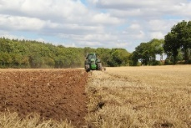

C7084 Big Data
Ed Harris
QUERY
DATA
Knowledge

Slide 2
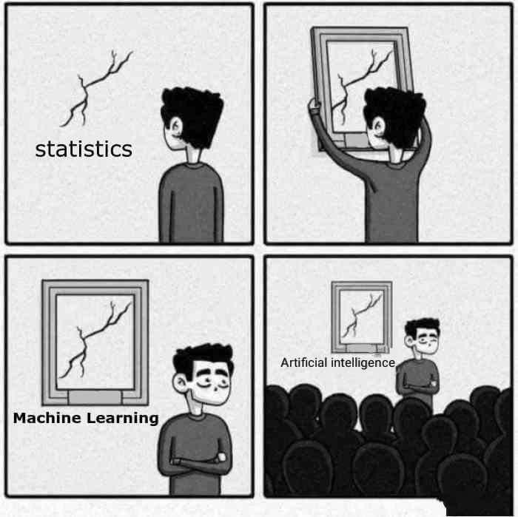
BIG
DATA

Slide 3
Table of Contents
Don't forget to start recording
Every session: community.cloud.databricks.com and Logon
In Left-pane, Click on 'Clusters' or 'Compute' and Terminate old Cluster Then click 'Create Cluster' button to create New one
Mod 00 – Intro and Setup
Mod 01 – Spark Architecture
Mod 02 – SparkSQL (Read/Write DataFrames/Tables)
Hacktivity 00 (Dates) / Hacktivity 01 (Air)
Mod 03 – SparkSQL (Transform)\
Mod 04 – Complex Data Types
Mod 05 – JSON (Optional)
Hacktivity 02 (Fly)
Mod 06 – Streaming
Mod 07 – Architecture-Spark UI
Mod 08 – Catalog-Catalyst-Tungsten
Mod 09 – Adaptive Query Execution
Mod 10 – Performance Tuning
Hacktivity 03 (Stream) / Hacktivity 04 (Air)
Mod 11 – Machine Learning

Slide 4
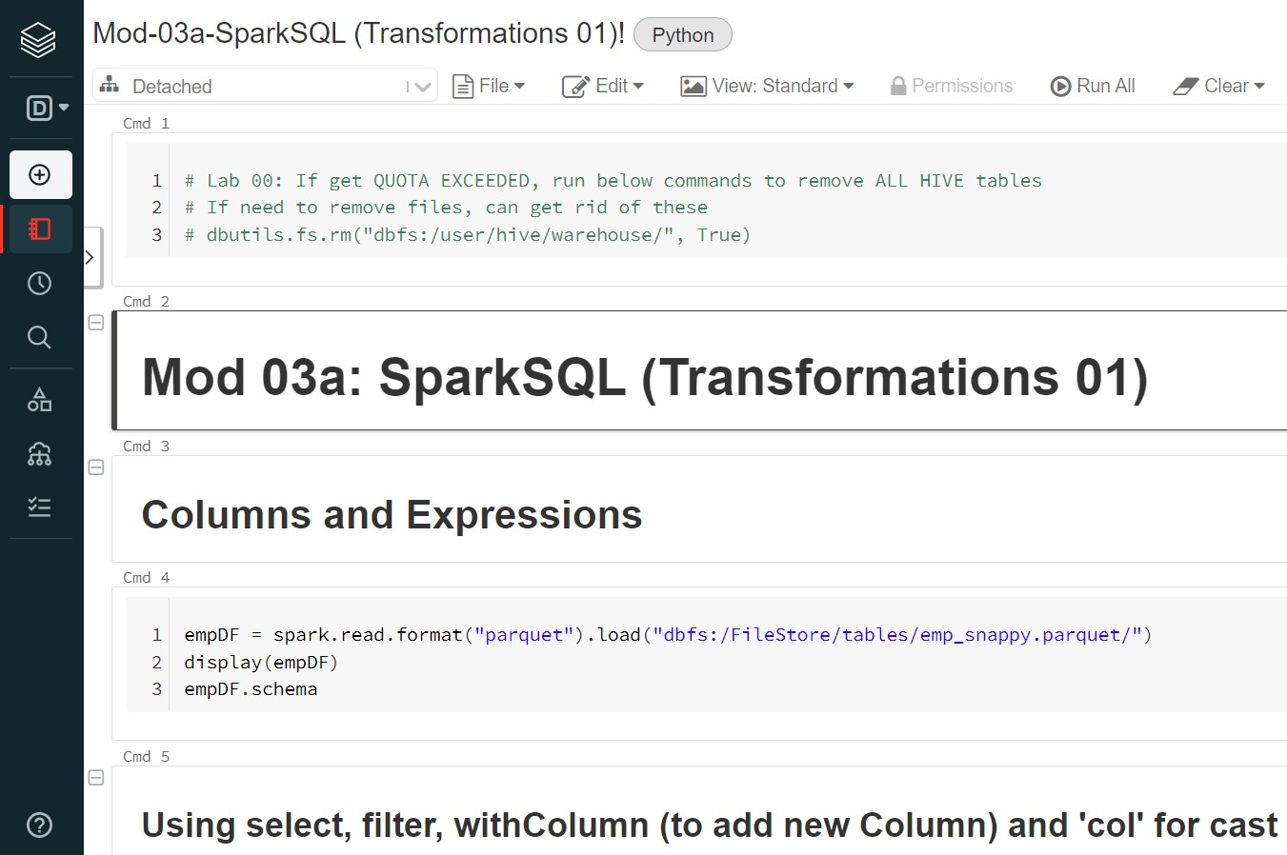
Before we Begin: Open Notebook Mod-03a

Slide 5
Module 03 – Spark SQL
After completing this module, you'll be able to work with Spark SQL including:
Transformations 01 Notebook
Columns and Expressions
Operators and Methods
Transformations and Actions
Transformation 02
Lab 01: Dates and Timestamps
Lab 02: Aggregations
Lab 03: Widgets
Non-Aggregate functions
Other built-in functions
Lab 04: User Defined Functions

Slide 6
Spark SQL – Columns and Expressions

Slide 7
Columns
Column is an object we will be transforming in a DataFrame/Table using an expression
In a DataFrame, you refer to a Column using various syntax including
df["columnName"]
df.columnName
col("columnName") col("columnName.field")
You can manufacture new values from Column values via Operators/Methods
col("x") * col("b")
col("x").asc()
col("x").cast("float") * 100

Slide 8
Column Operators and Methods
Operator/Method | Description
&, | | Boolean AND, OR in Python
*, + , <, >= | Math and comparison operators
==, != | Equality and inequality tests in Python
alias, as | Gives the column an alias, as only in Scala
cast, astype | Casts the column to different data type, astype only in Python
isNull, isNotNull, isNan | Is null, is not null, is NaN (Not A Number)
isin | Boolean evaluated to true if value contained by values of the arguments
asc, desc | Returns a sort expression based on ascending/descending order of the column

Slide 9
DataFrame Operations
DataFrames support two types of Operations:
1• Actions, which computes a result based on an DataFrame
Actions return a result either to the console or a written file
For example, in earlier labs, we used the display() function which is an Action to display the result set to the console
₂• Transformations, which create a new DataFrame from an existing DataFrame
For example, isin is a Transformation that passes each column value through a Boolean evaluation. If true, column values are returned
All Transformations in Spark are lazy, in that they do not compute their results right away. Instead, they just remember the Transformations applied to some base dataset (e.g. a file). The Transformations are only computed when an Action requires a result to be returned to the Driver program

Slide 10
DataFrame Transformations
Transformation | Description
select | Returns a new DataFrame by computing given expression
selectExpr | Variant of select() that accepts SQL expression and returns new DataFrame
drop | Returns a new DataFrame with a column dropped
withColumnRenamed | Returns a new DataFrame with a column renamed
withColumn | Returns a new DataFrame by adding a column or replacing the existing column that has the same name
filter, where | Filters rows using the given condition
sort, orderBy | Returns a new DataFrame sorted by the given expressions
dropDuplicates, distinct | Returns a new DataFrame with duplicate rows removed
limit | Returns a new DataFrame by taking the first n rows
groupBy | Groups DataFrame using specified columns, so we can run aggregation on them

Slide 11
DataFrame Actions
Operator/Method | Description
display | Displays the DataFrame in tabular form via http format
show | Displays the top n rows of DataFrame in a tabular form
count | Returns the number of rows in the DataFrame
describe, summary | Computes basic statistics for numeric and string columns
first, head | Returns the the first row
collect | Returns an array that contains all rows in this DataFrame
take | Returns an array of the first n rows in the DataFrame
Actions start the Execution of a Job

Slide 12
Spark SQL – Date and Timestamps (Start of Transformations 02)

Slide 13
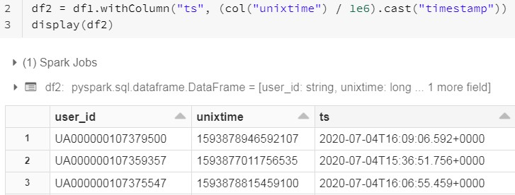
What is Unix Time?
Unix time is a system for describing a point in time. It is the number of micro- seconds that have elapsed since the Unix epoch, excluding leap seconds. The Unix epoch is 00:00:00 UTC on 1 January 1970
There are several ways to convert Unix time to Spark Timestamp format
https://www.unixtimestamp.com/

Slide 14


Built-in functions
Function | Description
date_format | Converts a date/timestamp/string to a value of string in the format specified by the date format given by the second argument.
add_months | Returns the date that is numMonths after startDate
to_date | Converts Column into pyspark.sql.types.DateType via optionally specified format
dayofweek | Extracts the day of the month as an integer from a given date/timestamp/string
date_add | Returns the date that is N days after start
from_unixtime | Converts the number of seconds from unix epoch (1970-01-01 00:00:00 UTC) to a string representing timestamp of that moment in current system time zone in given format
year | month | minute | second | Extracts the time frame as an integer from a given date/timestamp/string.
unix_timestamp | Converts time string with given pattern to Unix timestamp (in seconds)
https://s
park.apache.org/docs/latest/sql-ref-datetime-pattern.html

Slide 15
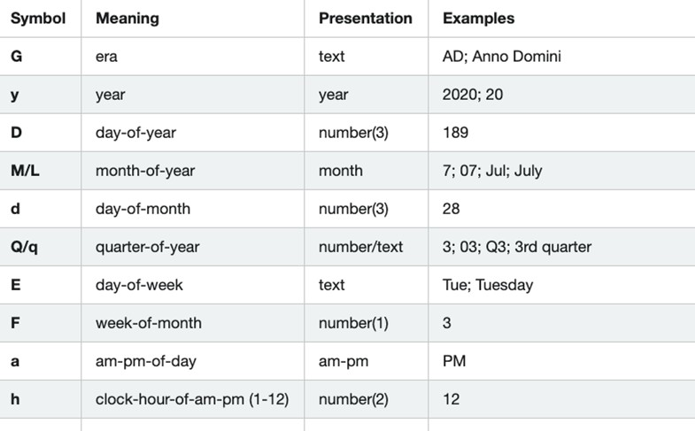
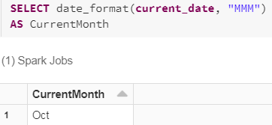
Date/Time Patterns

Slide 16
Spark SQL – Aggregations and Joins

Slide 17
Aggregate functions
Function | Description
agg | Compute aggregates by specifying a series of aggregate columns
avg | Compute the average value for each numeric columns for each group
count | Count the number of rows for each group
max | Compute the max value for each numeric columns for each group
mean | Compute the average value for each numeric columns for each group
min | Compute the min value for each numeric column for each group
pivot | Pivots a column of the current DataFrame and performs the specified aggregation
sum | Compute the sum for each numeric columns for each group

Slide 18
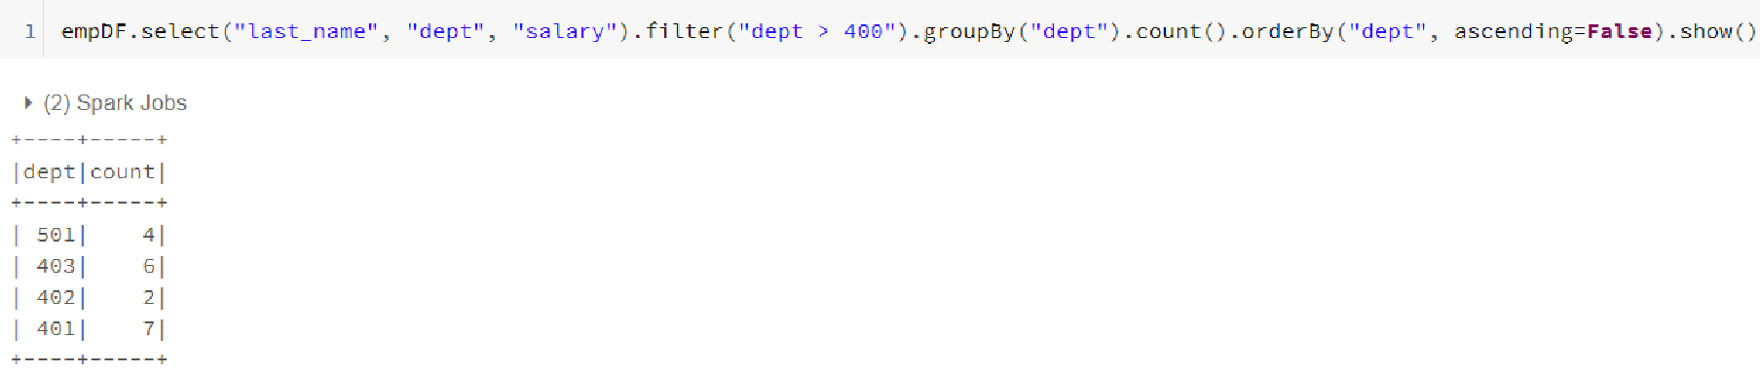
'groupBy' and 'count'
Query: Count how many rows per Dept where Dept > 400. Sort in Descending order by Dept

Slide 19
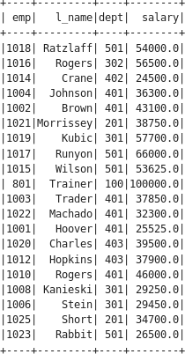
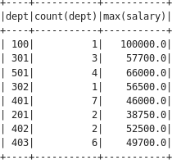
groupBy() with agg()
Query: For each 'Dept', do multiple aggregate.
Want Count # of row per 'Dept', Max 'salary' per 'Dept'
#// DataFrame query
empDF.select("dept", "salary").groupBy("dept").agg({"*": "count", "salary": "max"}).show()
#// SQL equivalent
spark.sql("select dept, count(*) as ct_dept, max(salary) as max_sal
from emp_tbl group by dept").show()

Slide 20
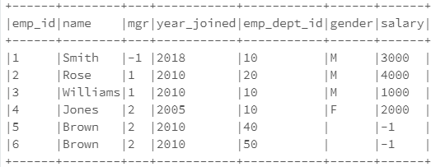
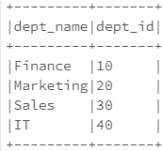
Join functions
Function | Description
join | Joins with another DataFrame. Supports INNER, LEFT OUTER, RIGHT OUTER, LEFTSEMI, LEFTANTI CROSS
empDF
deptDF

Slide 21
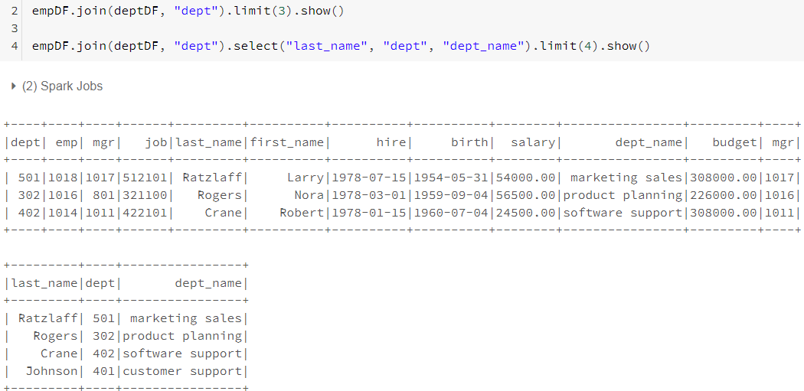
Inner join() using DataFrames
Join column

Slide 22
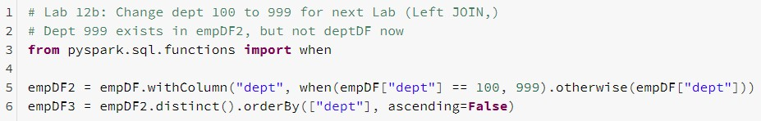
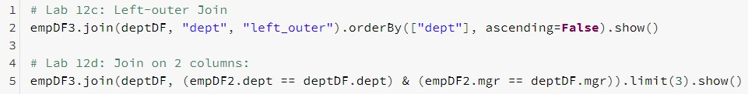
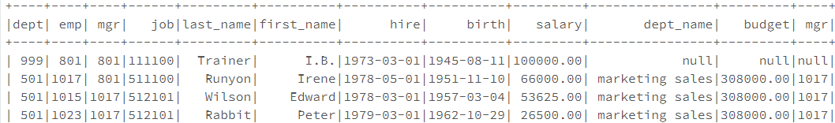
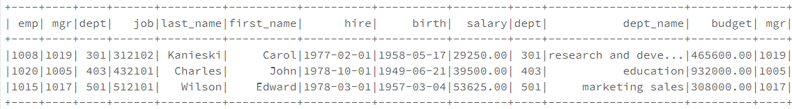
Left join() using DataFrames
 | Put invalid Dept 99 then do Left Ou | 9 in empDF, ter Join
Matching
Non-match

Slide 23
Spark SQL – Miscellaneous Functions (No labs on these)

Slide 24




Non-Aggregate Built-in functions
Function | Description
col | Returns a Column based on the given column name
lit | Creates a Column of literal value
IsNull | isNotNull | Return true if the column is null | Returns true if column is Not Null
concat | Concatenates multiple input columns together into a single column
rand | Generate a random column with independent and identically distributed (i.i.d.) samples uniformly distributed in [0.0, 1.0)
1st
2nd
3rd

Slide 25
String Built-in functions
Function | Description
translate | Translate any character in the src by a character in replaceString
regexp_replace | Replace all substrings of the specified string value that match regexp with rep
regexp_extract | Extract specific group matched by Java regex, from specified string column
ltrim | Removes the leading space characters from the specified string column
lower | Converts a string column to lowercase
split | Splits str around matches of the given pattern

Slide 26
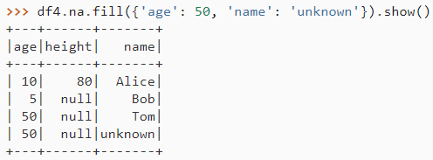
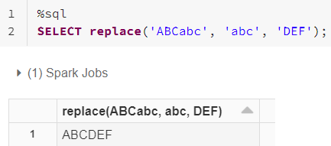
Na Built-in functions
Function | Description
na.drop | Returns a new DataFrame omitting rows with any, all, or a specified number of null values, considering an optional subset of columns
na.fill (value) | Replace NULL values with the specified value for an optional subset of columns
replace (str, search [,replace]) | Returns a new DataFrame replacing a value with another value, considering an optional subset of columns (Replaces all occurrences of 'search' with 'replace'
Fill NULL for 'age' with 50
Fill NULL for 'name' with 'unknown'
Replace 'abc' with 'DEF'

Slide 27
Spark SQL – Widgets

Slide 28
Widgets: Parameterize your Notebook
There are 4 types of Widgets
text:
dropdown:
combobox:
Input a value in a text box
Select a value from a list of provided values Combination of text and dropdown. Select a value from a provided list or input one in the text box.
multiselect: Select one or more values from a list of provided values

Slide 29
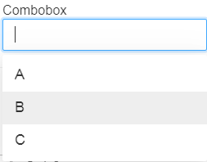
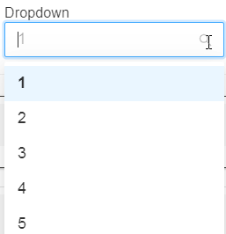
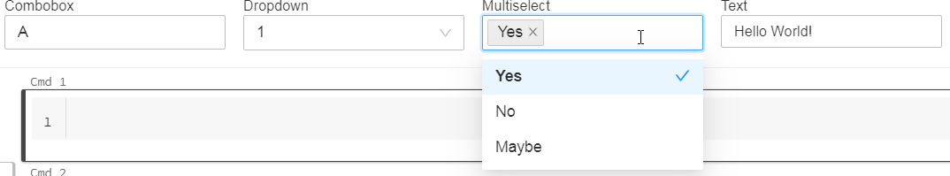

Widgets: Parameterize your Notebook
Free text here

Slide 30
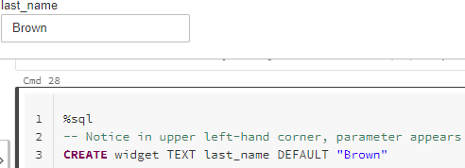
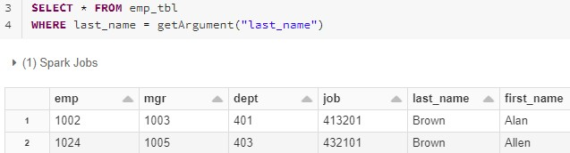

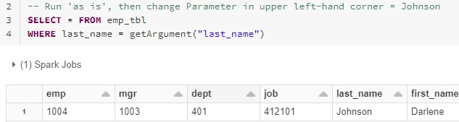
Widgets: Parameterize your Notebook

Slide 31
Spark SQL – User Defined Functions (UDFs)

Slide 32
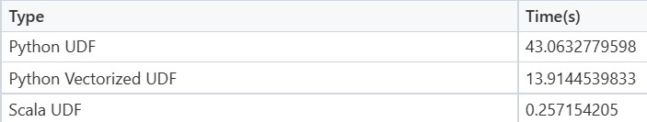
UDF Performance compared to built-in Functions
The Spark DataFrame functions are natively a JVM structure and standard access methods are implemented by simple calls to Java API. UDF from the other hand are implemented in Python and require moving data back and forth
In other words, Spark SQL functions operate directly on JVM and typically are well integrated with both Catalyst and Tungsten. It means these can be optimized in the execution plan and most of the time can benefit from Whole Stage Code Gen and other Tungsten optimizations. Moreover, these can operate on data in its "native" representation
In order of Preference when Performance is important:
Higher-Order functions
Pandas UDFs
Python UDFs
Using Scala UDFs in PySpark. TL;DR | by WB Advanced Analytics | wbaa | Medium

Slide 33
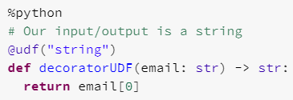
UDFs for DataFrames and Tables
UDF are when you wish to write custom Functions
UDFs are a 'black box' in the sense that the Catalyst optimizer cannot tune the query. Hence, performance goes down when compared to using a 'built-in' function
There are Performance differences between Scala and Python UDFs
Python incurs additional cost of Python interpreter
UDF's are Serialized and sent to the Executors for processing
This registers the UDF on the Executors

Slide 34
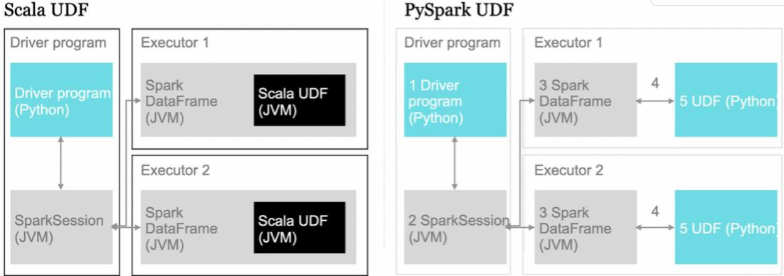
Python UDFs incur more cost compared to Scala UDFs
With Python, Inter-Process Communication (IPC) passes each row between UDF and Spark JVM
UDF registered on Executor
https://medium.com/quantumblack/spark-udf-deep-insights-in-performance-f0a95a4d8c62

Slide 35

UDFs for DataFrames and Tables (Scala)
Python UDF (slow)
Serialize/Deserialize data with Pickle
Fetch data block, but invoke UDF row by row
Pandas UDF (faster)
Data transfer without the cost of Serialization using Arrow
Fetch data block and invoke UDF block by block
Arrow format is an in-memory data format that was specifically designed to exchange the data between different systems efficiently
https://databricks.com/blog/2020/05/20/new-pandas-udfs-and-python-type-hints- in-the-upcoming-release-of-apache-spark-3-0.html

Slide 36
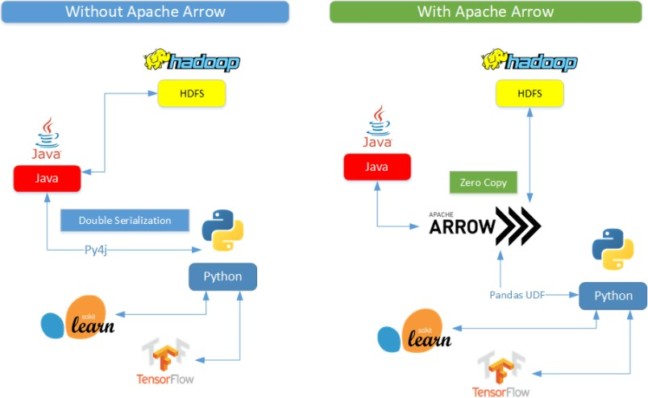
UDFs with/without Apache Arrow on Pandas
Apache Arrow is in-memory columnar format used in Spark to efficiently transfer data between JVM and Python. Beneficial to Python users that work with Pandas/NumPy data
Problem
Solution

Slide 37
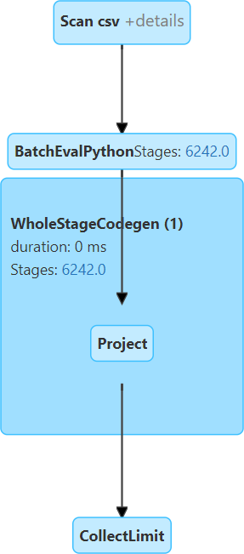
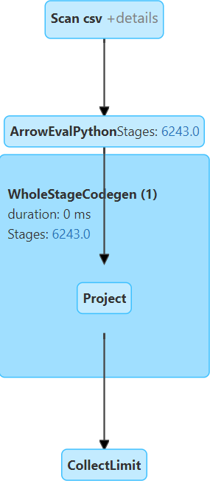
UDFs vs Panda UDFs

Slide 38
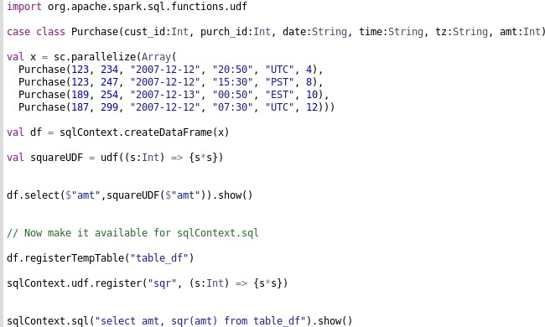
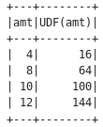

UDFs for DataFrames and Tables (Scala)
You can create your own User Defined Functions (UDF). You must:
Install correct UDF library for language you are working
Create named UDF for either DataFrames or Tables as needed
Need this UDF library
I create my UDF, then call it in DF
To use UDF in SQL table, must register it first

Slide 39
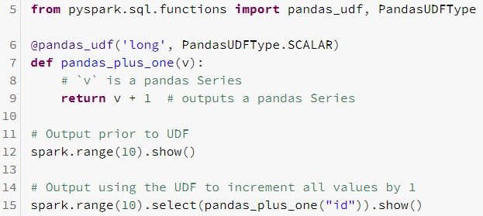

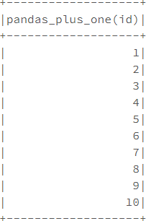
Creating UDFs for DataFrames

Slide 40
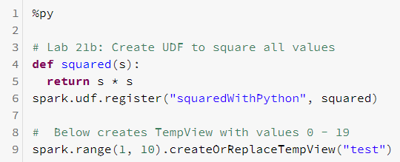
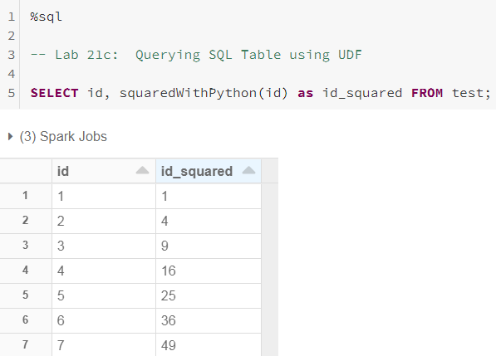
Creating UDFs for Table
Note you create the UDF in Python, which is then used in SQL API

Slide 41
In Review: Spark SQL
After completing this module, you'll be able to work with Spark SQL including:
Transformations 01 Notebook
Columns and Expressions
Operators and Methods
Transformations and Actions
Transformation 02
Lab 01: Dates and Timestamps
Lab 02: Aggregations
Lab 03: Widgets
Non-Aggregate functions
Other built-in functions
Lab 04: User Defined Functions

